Slide 1
The roles for evaluation in the not-for-profit sector in the 21st century
Les Hems, Director of Research,
Centre for Social Impact, University of new South Wales
Professor Paul Flatau, Centre for Social Impact, University of Western Australia
Australasian Evaluation Society Conference
2nd September 2011 - Sydney

Slide 2
The Centre for Social Impact
An independent research centre and “do-tank”
A collaboration of four universities
Strategic engagement with Commonwealth and state governments
Strategic engagement with corporates including Macquarie Group Foundation, NAB, Stockland, BHP Billiton, JBWere, Corrs Chambers Westgarth
Focus on social innovation / enterprise / investment – to support the creation of beneficial social impact
Notes:
Peter introduction

Slide 3
Four transformations
Individuals: From philanthropy to social impact investing
Government: From short term output driven commissioning to long term outcome based – “payment for success”
Not-for-profit organisations: From grant dependence to social enterprise
Financial Innovation: Financial mechanisms that blend commercial and social returns e.g. Microfinance and social impact bonds

Slide 4
1. Program evaluation - outcome based commissioning - social impact investing

Slide 5
Definition: Social Impact Investing
Impact investing seeks to deliver social and environmental benefits alongside a commercial return.
Based on “positive screening”
Closely related to socially responsible and ethical investing which are based on “negative screening” to exclude investments which are socially or environmentally damaging
Notes:
Les Hems

Slide 6
Notes:
The journey from philanthropy to social impact investing.
‘Investing for Social & Environmental Impact’ Monitor Institute
http://www.monitorinstitute.com/impactinvesting/
Christopher Thorne, JBWere Blog - http://bit.ly/k7BbE1 (cut and paste in to Browser)

Slide 7
Govt: “Payment for success”
Persisting “wicked problems”
Ineffective responses - complex multi-faceted problems, cross departmental silos
Continuing pressure on Government funding and conflicting priorities
Transformation
Outcome based commissioning
Results Based Accountability

Slide 8
NFP: Grants to enterprise
NFP’s dependence on government grants and donations
Philanthropic subsidy to cover full costs
Under capitalised
Transformation
Increasing focus on social enterprise
Increasing consideration of use of debt finance

Slide 9
Innovation in social finance
Constraints on traditional sources of funding have prompted financial innovation
Transformation
Microfinance – individuals and micro-enterprise (NAB)
International Finance Facility for Immunisation (IFFIm) Immunisation Bonds
GoodStart – a social investment partnership between NFPs, Government, NAB and private investors
Social Impact Bonds – UK and NSW
Notes:
International Finance Facility for Immunisation (IFFIm) Immunisation Bonds (see http://www.iff-immunisation.org/).

Slide 10
Emergence of an asset class?
Early signs:
Foresters Community Finance – Investing in Community Assets
AMP Community Infrastructure Fund
CalPERS – Californian Super Fund – Alternative Investments
Christian Super Fund – ethical investments and microfinance

Slide 11
Government initiatives
National Rental Affordability Scheme - NRAS
Community Development Finance Initiative (Australia and USA)
Priority Sector Lending (India)
Social Enterprise and Development Investment Fund (DEEWR)
Renewable Energy Fund (2011 Budget)
And more .... Pacific Community Ventures Insight
Notes:
“Impact investing: A framework for policy design and analysis” – January 2011 – Insight at Pacific Community Centures & the initiative for responsible investment at Harvard University – supported by the Rockefeller Foundation

Slide 12
Social Impact Bonds
Social Impact Bonds have the potential to exploit:
These transformations,
These early signs
International innovation
And also align incentives
Demonstration projects:
Social Finance UK – Peterborough Prison
Four further pilots in the UK
New South Wales Social Impact Bond Pilot

Slide 13
Recommended SIB structure
Social Impact
Investors
$
SIB Issue
$ Assignment of
Outcome Based Payment
Host not-for-profit organisation (NPO)
Outcome Based Agreement
Government
$ Outcome Based Payment
Program(s)
Notes:
The structure recommended by CSI positions the host NPO as the issuer of the SIB. This structure recognizes the clear feedback provided to CSI during our interviewing of key stakeholders of the desire of social impact investors to have a direct relationship with the host NPO and for the host NPO to have a direct relationship with government.

Slide 14
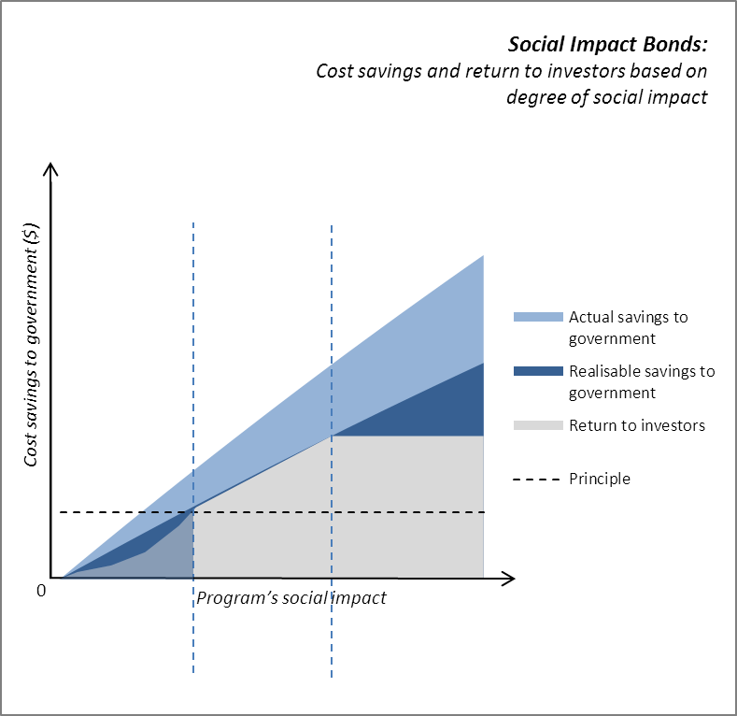

Slide 15
Our overarching conclusions
CSI believes that:
The SIB concept is feasible and
NSW does have the necessary ingredients
BUT
There is much work to be done to deliver a SIB pilot in NSW
The SIB structure must be customized for the local context
Evidence and measurement are the biggest challenges

Slide 16
Key challenges ahead
Robustness of evidence and measurement
Of the efficacy of program interventions
Tools
Economic and financial models
Of the desired outcome – financial and social
Of the target client cohort
Social return on investment
Case management systems
Longitudinal measurement methodologies
Notes:
The construction, issuing and operation of a SIB are heavily dependent on the robustness of evidence and measurement of the efficacy of program interventions.
Evidence and measurement give confidence to government, NPOs and investors that the agreed outcomes can be achieved.
There has been increasing emphasis in social programs and social interventions in NSW on gathering evidence on client outcomes, but there remains room for improvement in this area, particularly in terms of accepted robust evidence on intervention effectiveness.
The emergence of tools such as Social Return on Investment will assist NPOs, government and investors to assess risk. However, the discussions with government, NPOs and evaluation experts suggest that many NPOs need to invest in developing more robust and continuous performance measurement systems and evaluation methodologies. Government and NPOs also need to consider how they can integrate administrative and program data.
Capacity building will be needed on evaluation and measurement. Critical that such is designed to enable all potential hosts NPOs – small, medium, large or SEs – to access thus participate in SIBs.

Slide 17
Development of a capital market for social investment
Dependent on evidence & measurement:
Quality of evidence determined by quality of measurement.
Data & analysis accumulates over time to improve the quality
2 measurement components – performance and risk
Multiple dimensions – program, organisation, system and sector
Investment in social innovation - early intervention or scale proven innovation
Transparency and open analysis – publicly available market data and analysis – investor relations
Market intelligence–products, businesses, markets & funds
Notes:
Peter introduction

Slide 18
Impacts and Measurement Issues SIB
Initiative (Ideas, stakeholders, activities)
Finance (Investors, government funder)
Targets (Performance benchmarks)
Impact (Immediate outcomes and long-term impacts)
Measurement (Effectiveness and Cost-Benefit)
Return

Slide 19
Issues
Impact and Measurement
There are two critical questions?
Q1: What is the social impact of a given SIB initiative? And what is its dollar impact on funders?
Q2: What constitutes valid and robust evidence on impact?

Slide 20
Two Fundamental Questions
Q1: What is the social impact of the SIB initiative?
Does the initiative work? What is the size of the impact for participants?
What downstream impacts does the initiative have on ultimate funder (typically government) costs and revenues?
Why does the initiative work? (Why doesn’t it work?)
To answer this question we need …
Theory (relating inputs, outputs, outcomes and impacts)
Hypotheses (of relationships between inputs and outcomes)
Data (on inputs, outputs, outcomes and impacts)
Tests of hypotheses (on outcomes/impacts)
Valuation (dollar impact)

Slide 21
Issues
Key links to evaluation….
Theory of change logic models
Impact evaluation
Economic evaluation (Cost-Benefit Analysis)
In the case of the SIB a quantitative approach is required as is economic evaluation but broader evaluation

Slide 22
Methodological Issues
Q2: What constitutes valid and robust evidence on impact?
Contested terrain !
Is impact evaluation limited to Randomised Control Trials or quasi-experimental analysis?
Who is right?
What of knowledge grounded in the evidence derived from the observed and expressed experiences of participants, workers, and managers of the initiative?

Slide 23
Research Methods
Quantitative research methods
Randomised control trials
Quasi-experimental
Longitudinal data, cross-sectional, time series data

Slide 24
Research methods Quantitative
Randomised Control Trials
Source: Magenta Book Background Papers Paper 7: why do social experiments? (p3)

Slide 25
Research methods Quantitative - RCT
What is the key benefit of the RCT?
With a large enough sample no systematic difference in the treatment and control groups is apparent.
Hence statistically significant difference in the average value of outcomes for the treatment and control group (Δ= Y^{p}-Y^{c}) must be the result of the impact of the initiative alone.

Slide 26
Research methods Quantitative - RCT
What are issues in the use of RCT?
It disturbs what would naturally occur (generally)
Samples used are often relatively small so that only the average differential impact can be reported (but there may be significant within group differences)
The Hawthorne Effect: those selected in the treatment group may act differently than they otherwise would because they have been selected for treatment. Those in the control group may also act differently ‘resentful demoralisation’
cont….

Slide 27
Research methods Quantitative - RCT
Substitution bias and contamination or crossover effects: some or many in the control group seek out or are provided with alternative options for treatment or in fact receive the treatment in one form or another
Scale bias: RCT are generally small and run as demonstrations and as such may fail to capture community wide effects
Causality: Focus on effectiveness outcomes alone but no explanation of why the initiative works,

Slide 28
Research methods Quantitative - RCT
What are the ethical issues in RCT?
In spite of the claim that prior to the evidence, we don’t know whether the initiative is successful or not, there is generally a presumption that the initiative is superior to the counterfactual. That is, after all, why the program has been implemented.
Those who do not receive treatment are at an assumed to be at a disadvantage. An allocation of study participants to the ‘non-treatment’ group is an assignment to a predicted worse outcome for the client.

Slide 29
Research methods Quantitative - RCT
The ethical problem remains even in the case of resource constraints. Such constraints mean that not all who are eligible and wish to participate in the initiative can do so. This is because services delivering the initiative may adhere to a needs-based allocation policy.
The process of randomisation may interfere with such an allocation system as it replaces a needs-based allocation model with one based on random allocation. The implementation of the RCT means that some potential clients with high needs have missed receiving support under the program where otherwise they would have received support.

Slide 30
Research methods Quantitative – Quasi-experimental
Quasi-experimental studies are studies which either use ‘naturally occurring’ experiments or statistical techniques to generate measures of effectiveness
Single group pre and post-initiative
Two group pre and post-initiative with or without statistical matching (e.g., via propensity score methods)
Interrupted time series design

Slide 31
Research methods Quantitative – Quasi-experimental
Single group pre and post-initiative (problematic – why?)
Magenta Book Background Papers Paper 7: why do social experiments?

Slide 32
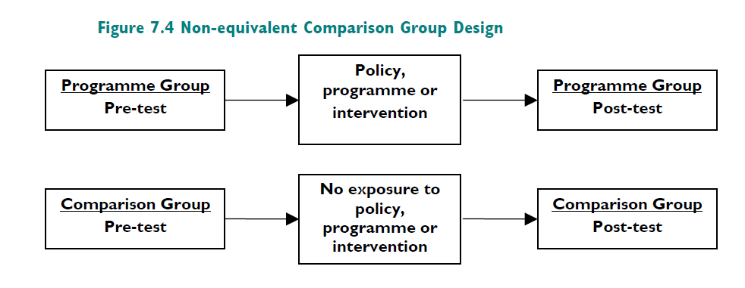
Research methods Quantitative – Quasi-experimental
Comparison group design (with controls in the case of relevant longitudinal or cross-sectional survey data) and matching samples

Slide 33
Key elements for robust measurement
Emphasis on client outcomes –clearly defined outcomes which articulate success and failure (continuum)
Longitudinal methods - not short term inputs and outputs
Cohort definition and segmentation – in the context of the wider population
Measure the “treatment” effect
Invest in understanding and measuring the counterfactual
Linked administrative data sets – not just in heath
Link program and organisation data to administrative data
Evaluate using both social and economic dimensions – VFM & SROI

Slide 34
Economic Evaluation
The SIB relies crucially on an evaluation of dollar impact for the ‘funder’ of the payment of return (the government in the present SIB examples)
What cost savings and revenue gains does the funder get from the initiative?

Slide 35
Use of economic models
Components of an economic model:
Cohort definition and segmentation – including cohort dynamics
Define desired outcome including defining success
Success looks different for each segment
Different programs – and therefore costs for each segment
Estimate (and evidence) “treatment effect” for each program / cohort segment
Link treatment effect to future cost savings for government – cost benefit analysis
Link treatment effect to other benefits to society - SROI
Transform economic model into a financial model

Slide 36
Costs
client
quantified
not quantified
quantified
Control
Vulnerability
(high, medium or low)
Quantifiable costs
to society or government
Total costs
Other societal costs
Cost of current program
(if applicable)
]
Treatment group expected to have a larger treatment effect and lower total costs than Control.
Treatment
Vulnerability
(high, medium or low)
Quantifiable costs
to society or government
Total costs
Other societal costs
Cost of proposed program
Reduction in these costs is the treatment effect.
Savings
Social impact investment partnerships: Economic model structure

Slide 37
Illustration
Consider a homelessness initiative for a SIB
Homelessness Initiative
Counterfactual; No Initiative
Potential Costs:
E.g., Significant capital investment in terms of dwellings and recurrent expenditure on staff and other resources
Potential Outcomes:
E.g., Stabilisation of condition, employment options, improved quality of life, reduced use of health and justice facilities
Potential Costs:
E.g., Significant costs associated with utilisation of acute psychiatric units, emergency departments, police and justice facilities
Potential Outcomes:
E.g., Worsening of condition, no employment prospects, poor quality of life

Slide 38
AHURI Study Potential Cost Offsets for Government
Health:
General Practitioner consultations, Medical specialist consultations, Nurse or other health professional worker consultations, Home Visits, Overnight hospital stays, Casualty or Emergency, Outpatients at Hospital or Day Clinic consultations, Other health workers, Ambulance services
Justice:
victim of an assault/theft/robbery which resulted in police contact/investigation; stopped by the police on the street; Stopped by the police in a vehicle; Apprehended by the police; Held overnight by the police; Court; Prison; Detention/remand/correctional facility; Visits to or received visits from Justice officers

Slide 39
AHURI Study Potential Cost Offsets for Government
General Population
Health & Justice
Client Population
Health & Justice
12 months prior
12 months later
Survey point
Differential :
‘Potential’ Cost Offsets

Slide 40
AHURI Study Potential Cost Offsets for Government

Slide 41
3. Capacity building – the role for academia

Slide 42
What needs to change?
Not-for-profits & social enterprises/businesses:
Shift focus from short to long term
Develop and maintain longitudinal data sets focused on outcomes
Profile and segment clients and define success for each segment
Client management system
Not just treatment effect – but counterfactual
Link to administrative data – data sharing protocols
Investor relations

Slide 43
What needs to change?
Government:
Shift focus from short to long term
Focus on outcomes – outcome based funding agreements
Build outcome measurement in to agreements
Learn through measurement – pilots and demonstration projects
Ensure administrative data is capturing key data necessary
Link data across silos – data sharing protocols
Make data available to bona fide researchers

Slide 44
What needs to change?
Investors:
Shift focus from short to long term
Shift focus from commercial to blended return
Engage advisors and investment analysts
Encourage specialists – specialists organisations (New Philanthropy Capital) and specialist individuals within financial institutions
Develop robust frameworks for performance (social and commercial) and risk
Funds, products (bonds) and direct investments

Slide 45
What else needs to change?
Knowledge / intelligence / information / data exchange (with competency & capacity) – “Knowledge Integration”
Engage big 4 audit & accounting firms & others to building economic and financial models
Engage evaluation experts
Universities to get involved – long term collaborative research programs with NFPs / social enterprises
Long term (7 year) strategy and funding to ensure all the above is achieved

